Slide 1

Case Study #4
Memi Lavi
www.memilavi.com

Slide 2

PayRawl

Slide 3
PayRawl
Payment processing system
Receives files from various sources
Validates and processes the files
Sends instruction files to banks
Fully automatic, no UI

Slide 4
Requirements
Functional
Non-Functional
What the system should do
What the system should deal with
Receive file to be processed
Validate and process the file
Work with various file formats
Perform various calculations on the file
Create bank payment file
Put the payment file in a designated folder
Keep log of all the activity for 7 years

Slide 5
NFR - What We Ask
“How many files per day?”
“How long should the process take?”
“What is the average size of a file?”
“Can we tolerate data loss?”
500
1 min
1MB
Absolutely Not!

Slide 6
Data Volume - Files
1 File = 1MB
500 files / day = 500MB / day
=> ~182GB / year
=> ~1.3TB / 7 years

Slide 7
Data Volume - Log
Assuming each processing generates 500KB log data
500 files / day = 250MB log data / day
=> ~91GB log data / year
=> ~638GB log data / 7 years

Slide 8
Requirements
Functional
Non-Functional
What the system should do
What the system should deal with
Receive file to be processed
Validate and process the file
Work with various file formats
Performs various calculations on the file
Create bank payment file
Put the payment file in a designated folder
Keep log of all the activity for 7 years
500 files / day
No data loss
1 min processing time
Activity log for 7 years
~2TB / 7 years

Slide 9

Components
Receive file to be processed
Validate and process the file
Work with various file formats
Perform various calculations on the file
Create bank payment file
Put the payment file in a designated folder
Keep log of all the activity for 7 years
Logs
Exports file to bank folder
Convert files to unified format
Gets files from folders
Performs calculations
File Exporter
File Formatter
File Handler
Files Queue
File Formatter
Formatted Files Queue
File Calculation
Calculated Files Queue
File Formatter

Slide 10
The Queue
Receive file to be processed
Validate and process the file
Work with various file formats
Perform various calculations on the file
Create bank payment file
Put the payment file in a designated folder
Keep log of all the activity for 7 years
Logs
Exports file to bank folder
Convert files to unified format
Gets files from folders
Performs calculations
File Exporter
File Formatter
File Handler
Files Queue
File Formatter
Formatted Files Queue
File Calculation
Calculated Files Queue
File Formatter

Slide 11
The Queue
- Passes payloads from logic unit to another
- Balances load
Persists messages (Durability!)

Slide 12
The Queue
Asynchronous
Which is good since we don’t have UI

Slide 13


The Queue
Which queue?
General purpose
Easy to setup
Not suitable for streaming scenarios
Great for streaming scenarios and high-load systems
Complex to setup

Slide 14
The Queue
Which queue?
General purpose
Easy to setup
Not suitable for streaming scenarios

Slide 15
The Queue
Queue is usually represented like this:
So…

Slide 16
Components
Receive file to be processed
Validate and process the file
Work with various file formats
Performs various calculations on the file
Create bank payment file
Put the payment file in a designated folder
Keep log of all the activity for 7 years
Logs
Exports file to bank folder
Convert files to unified format
Gets files from folders
Performs calculations
File Exporter
File Formatter
File Handler
Files Queue
File Formatter
Formatted Files Queue
File Calculation
Calculated Files Queue
File Formatter

Slide 17
Components
Receive file to be processed
Validate and process the file
Work with various file formats
Performs various calculations on the file
Create bank payment file
Put the payment file in a designated folder
Keep log of all the activity for 7 years
Logs
Exports file to bank folder
Convert files to unified format
Gets files from folders
Performs calculations
File Exporter
File Formatter
File Handler
File Formatter
File Calculation
File Formatter

Slide 18
Components
Logs
Exports file to bank folder
Convert files to unified format
Gets files from folders
Performs calculations
File Exporter
File Formatter
File Handler
File Formatter
File Calculation
File Formatter

Slide 19
File Handler
What it does:
Pulls payment files from folders
Put the files in the queue

Slide 20

Application Type
Web App & Web API
Mobile App
Console
Service
Desktop App

Slide 21
Technology Stack
Considerations:
Should be able to pull files from folders
Should be able to connect to queue
Not much else…

Slide 22


Technology Stack
This is a brand new company, we don’t have existing knowledge. What would you recommend?

Slide 23
Technology Stack
What we’re looking for:
Performance
Community
Cross Platform
Easy to learn and use
Evolving
Great threading support

Slide 24



Technology Stack
Our candidates:

Slide 25
Technology Stack
Node is mainly for web apps, our component is a service, so…

Slide 26
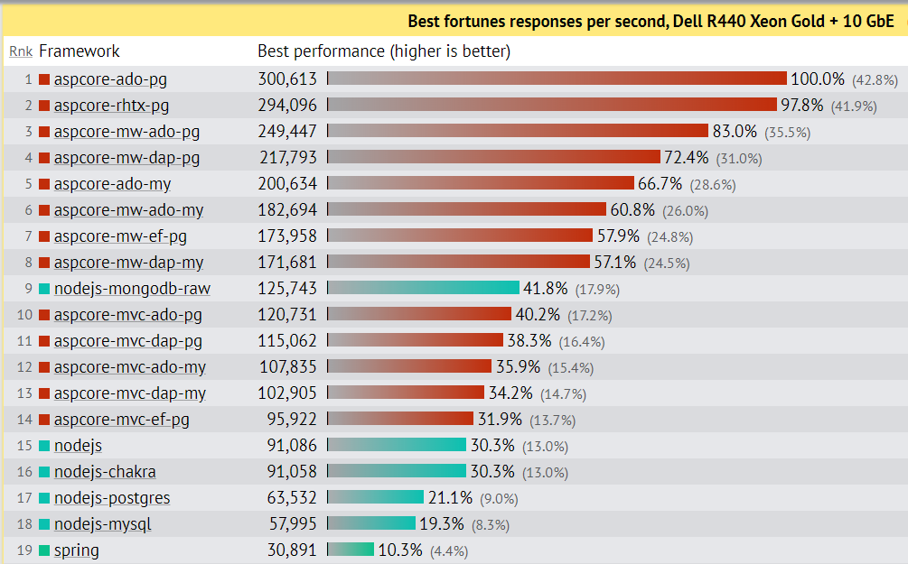
Technology Stack
Performance:
Source: https://www.techempower.com/benchmarks/#section=data-r18&hw=ph&test=fortune&l=zik0ot-f&p=zik0zj-zijocf-zijocf-4atpfj

Slide 27
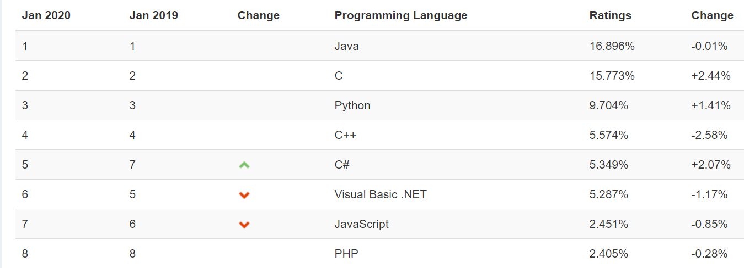
Technology Stack
Community:
Source: https://www.tiobe.com/tiobe-index/

Slide 28

Technology Stack
Cross Platform:

Slide 29
Technology Stack
Ease to learn and use:

Slide 30
Technology Stack
Evolving?
Next versions planned until 2021
Roadmap announced until 2023

Slide 31
Technology Stack
Threading support:

Slide 32
Technology Stack - Decision

Slide 33
Architecture
Traditional:
User Interface / Service Interface
Business Logic
Data Access
Data Store

Slide 34
Architecture
File Watcher
Topic is selected by file location

Slide 35
Redundancy
File Handler
Is Alive
File Handler

Slide 36
Components
Logs
Exports file to bank folder
Convert files to unified format
Gets files from folders
Performs calculations
File Exporter
File Formatter
File Handler
File Formatter
File Calculation
File Formatter

Slide 37
File Formatter
What it does:
Receives files from its specific topic
Validates and formats the file to unified format
Puts the new file in a queue
New formatters will be developed for new file formats

Slide 38
Application Type
Web App & Web API
Mobile App
Console
Service
Desktop App

Slide 39
Technology Stack

Slide 40
Architecture
Queue Receiver
Business Logic

Slide 41
File Formatter Redundancy
Consumer Group
File Formatter
File Formatter
File Formatter

Slide 42
Components
Logs
Exports file to bank folder
Convert files to unified format
Gets files from folders
Performs calculations
File Exporter
File Formatter
File Handler
File Formatter
File Calculation
File Formatter

Slide 43
File Calculation
What it does:
Receives files from the queue
Performs some calculations on the data
Puts the new file in a queue

Slide 44
File Calculation
Quite similar to the file formatter, so:
Tech Stack: .NET Core
2 layers architecture
Redundancy using Consumer Group

Slide 45
Components
Logs
Exports file to bank folder
Convert files to unified format
Gets files from folders
Performs calculations
File Exporter
File Formatter
File Handler
File Formatter
File Calculation
File Formatter

Slide 46
File Exporter
What it does:
Receives files from the queue
Puts the file in the bank’s folder

Slide 47
File Exporter
Quite similar to the file calculation service, so:
Tech Stack: .NET Core
2 layers architecture
Redundancy using Consumer Group

Slide 48
Components
Logs
Exports file to bank folder
Convert files to unified format
Gets files from folders
Performs calculations
File Exporter
File Formatter
File Handler
File Formatter
File Calculation
File Formatter

Slide 49
Requirements
Functional
Non-Functional
What the system should do
What the system should deal with
Receive file to be processed
Validate and process the file
Work with various file formats
Performs various calculations on the file
Create bank payment file
Put the payment file in a designated folder
Keep log of all the activity for 7 years
500 files / day
No data loss
1 min processing time
Activity log for 7 years
~2TB / 7 years

Slide 50
Logging
What we need:
Write a lot of log records
Allow easy visualizations and analytics
Preferably – based on existing platform

Slide 51



Logging
Most popular:

Slide 52
Logging
The Elastic Stack has 4 tools:
Elastic Search: Search and analytics engine
Kibana: Visualization engine
Logstash: Data collection pipeline
Beats: Lightweight log shippers

Slide 53
Logging
Or:
Elastic Search stores your log
Kibana displays the logs
Logstash and Beats bring your logs to Elastic

Slide 54
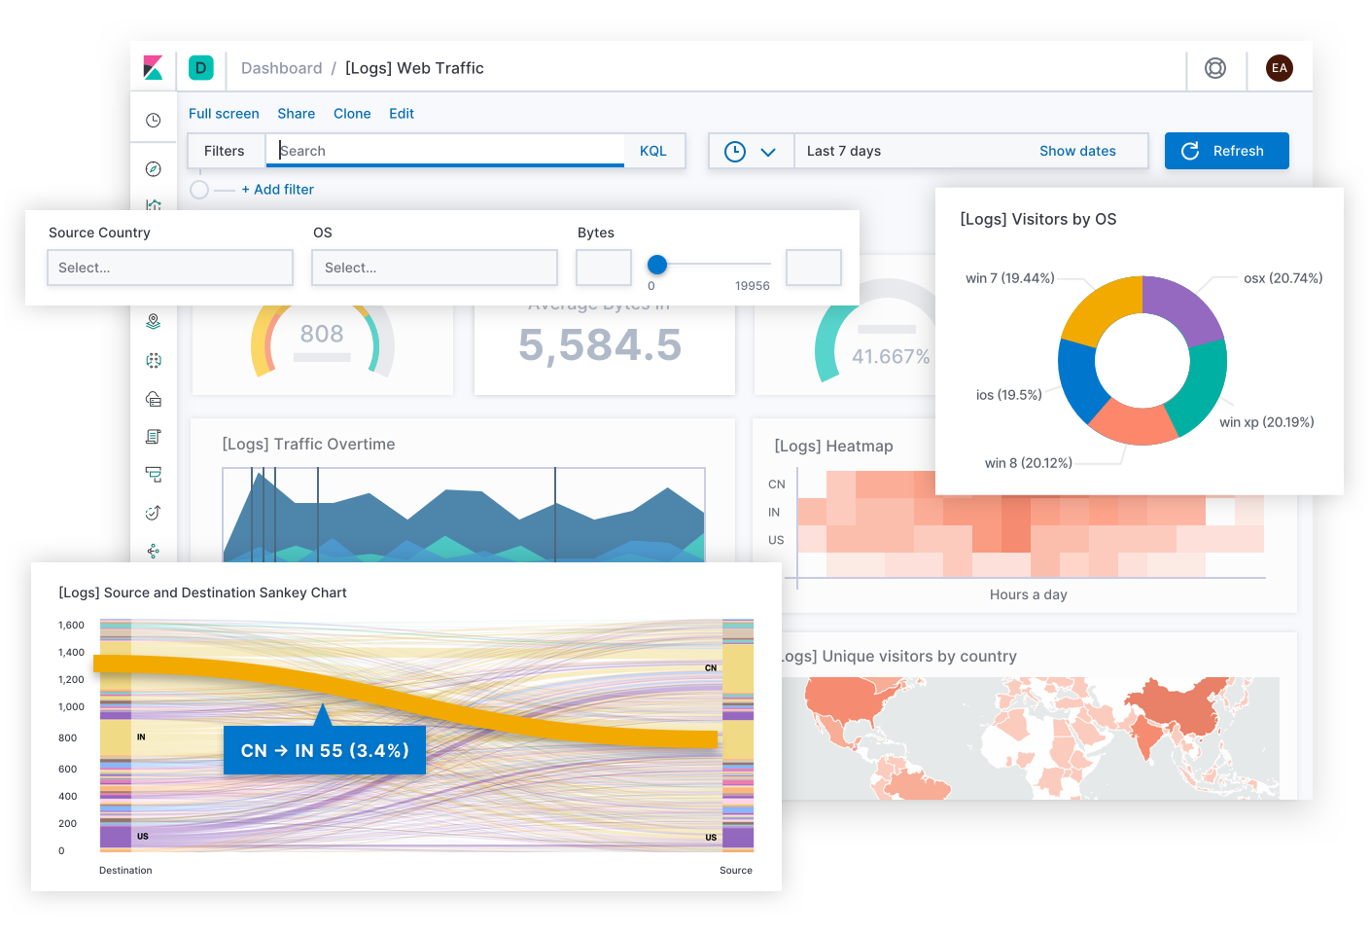
Logging

Slide 55
Logging
How do we ship logs from .NET Core to Elastic?

Slide 56
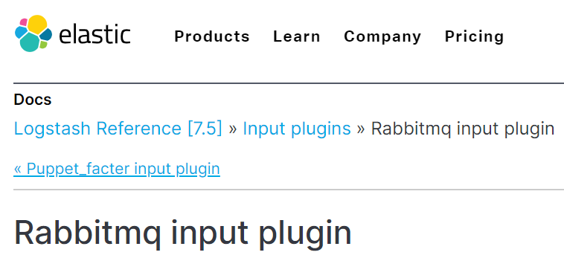
Logging
How do we ship logs from RabbitMQ to Elastic?

Slide 57
Components
Kibana
Elastic
logstash
Serilog
logstash
Serilog
logstash
Serilog
File Exporter
File Formatter
Serilog
File Handler
File Formatter
File Calculation
File Formatter

Slide 58
Logic Diagram
Logs
File Exporter
File Formatter
File Handler
File Formatter
File Calculation
File Formatter

Slide 59
Technical Diagram
Logs
Elastic Stack
.NET Core
File Exporter
File Formatter
.NET Core
File Handler
File Formatter
File Calculation
.NET Core
RabbitMQ
RabbitMQ
.NET Core
RabbitMQ
File Formatter

Slide 60
Physical Diagram
Logs
Consumer Group
Consumer Group
File Exporter
File Formatter
File Exporter
Is Alive
File Handler
File Formatter
File Calculation
File Handler
File Calculation
File Formatter
Consumer Group

